Slide 1
ASTRAWATCH
Monitoring Global Space and Space Security Developments
Rachel Manis | 18 January 2026

Slide 2
PROJECT OVERVIEW
Scope: Global
Time Period: November 2025 – January 2026
Data Souces: Open-source space security news
Data Approach: Ingestion | Processing | Analysis | Visualization

Slide 3
SOLUTION AND BENEFITS
Trend identification
Situational awareness
Drill-down analysis
Solution
Benefits
End-to-end data pipeline
Structured categorization
Interactive dashboard
Trend identification
Situational awareness
Drill-down analysis

Slide 4
TARGET AUDIENCE
Identify the target audience or potential users of your project.
Discuss how your project caters to their needs or interests.
Intel Analysts
Growing Body of Space Security Researchers
Policy and Security Professionals (Sensitization)

Slide 5
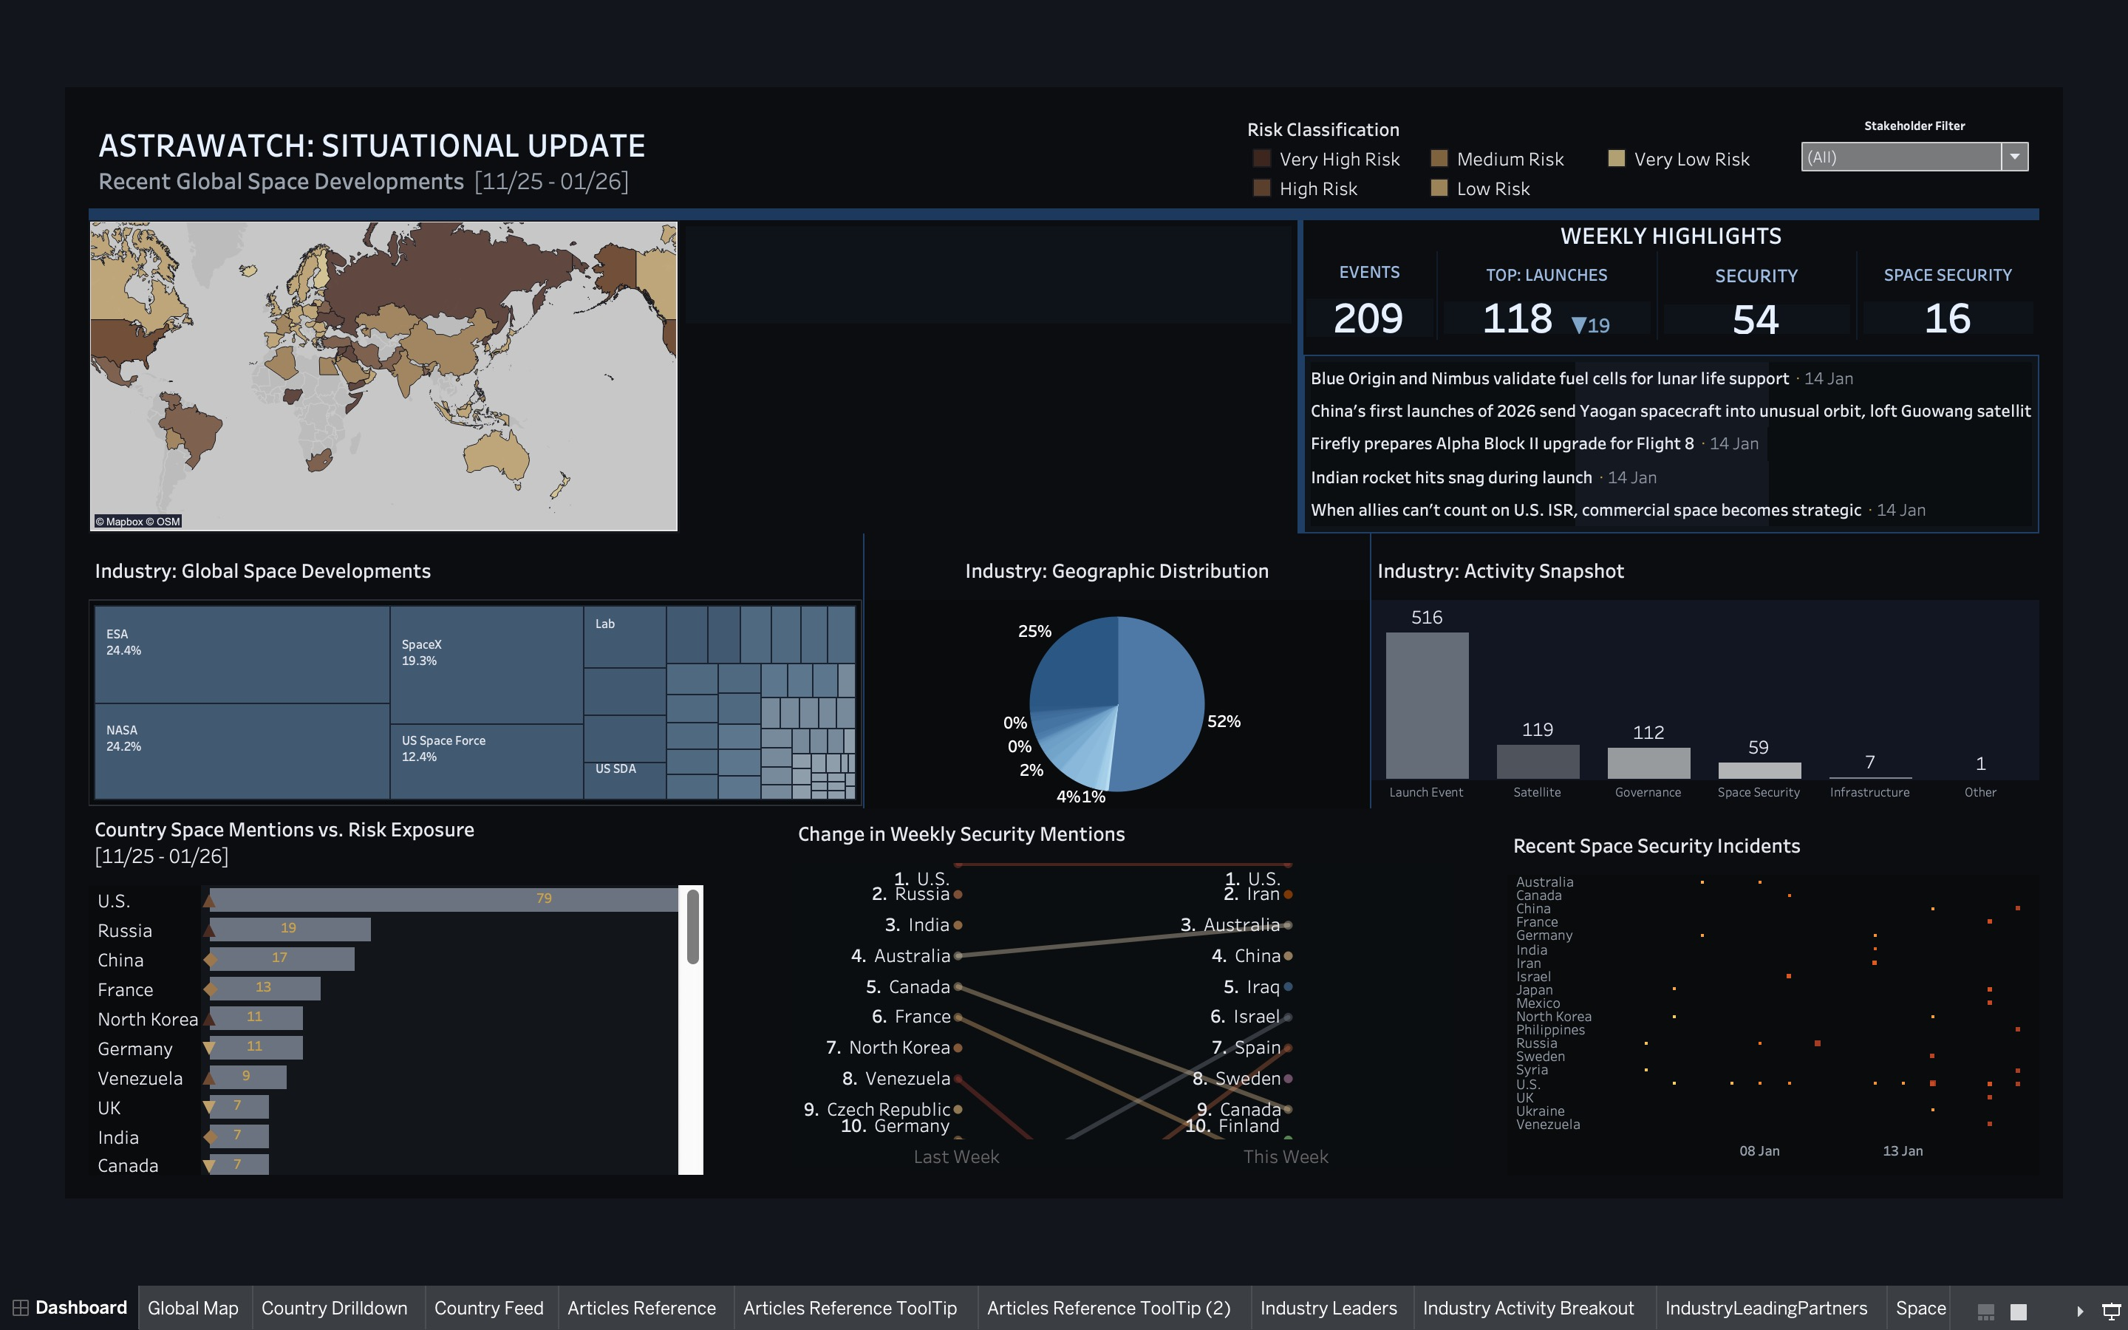
DEMONSTRATION
Identify the target audience or potential users of your project.
Discuss how your project caters to their needs or interests.

Slide 6
IMPLEMENTATION EXPERIENCE
Identify the target audience or potential users of your project.
Discuss how your project caters to their needs or interests.
Unstructured text data
Irrelevant or missed articles
Entity ambiguity
Approach
Keyword filtering
Deduplication
SQL queries to validate
Challenges

Slide 7
FUTURE ENHANCEMENTS
Identify the target audience or potential users of your project.
Discuss how your project caters to their needs or interests.
Automated updates
NLP-based entity recognition
Expanded risk indicators

Slide 8
ASTRAWATCH TAKEAWAYS:
Identify the target audience or potential users of your project.
Discuss how your project caters to their needs or interests.
- Successfully demonstrates how open-source data can be transformed into actionable space-security insights.
Ready for ongoing monitoring.
Capable of easily integrating new extensions

